Slide 1
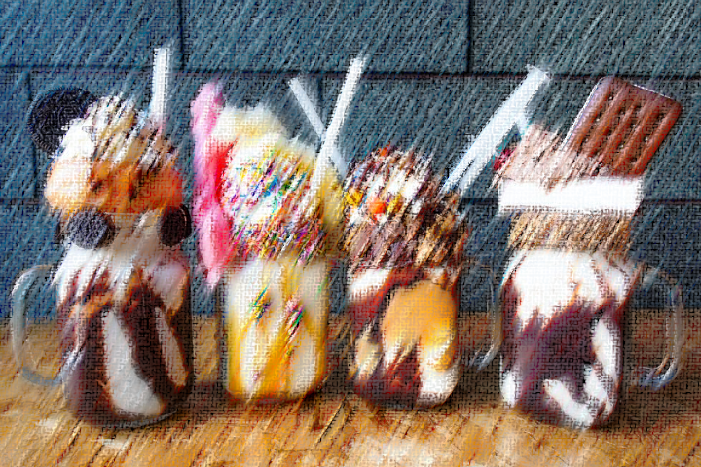


Class: Transfer Learning
Petia Radeva
Universitat de Barcelona &
Computer Vision Center

Slide 2
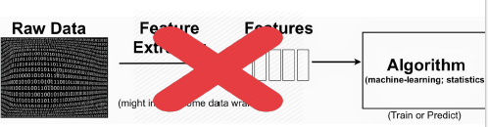
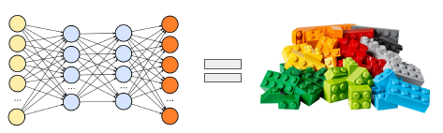
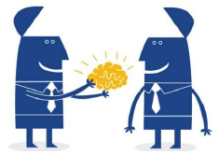
What makes DNN so popular?
It has three main advantages:
1. Self-learned high-level features representations
2. Modularity
3. Transfer Learning

Slide 3
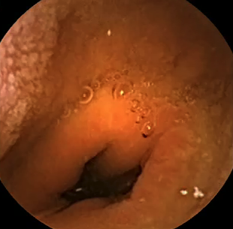
Transfer Learning and Fine-tuning
Bubbles
Turbids
Contraction
Wall
….
Example of Fine-tuning

Slide 4
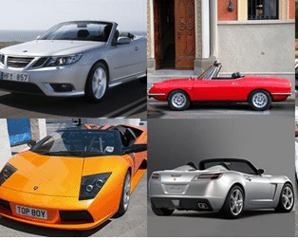

Full (Re)Training or Fine-Tuning?
Non-medical and medical images share characteristics
Update the W_{i} parameters
It has been shown that it is better to fine tune pre-trained models (incl. those trained with non-medical images)
The training converges faster
Tajbakhsh, N. et al. 2016. Convolutional neural networks for medical image analysis: Full training or fine tuning?. IEEE Transactions on Medical imaging, 35(5), pp.1299-1312.
Notes:
Happy to talk to you today about some recent work that points out opportunities for Radiology, and how they might impact PACS systems and workstations in the not too distant future.

Slide 5
Full (Re)Training or Fine-Tuning?
Notes:
Happy to talk to you today about some recent work that points out opportunities for Radiology, and how they might impact PACS systems and workstations in the not too distant future.

Slide 6


Transfer Learning Methods: Using pre-trained CNN features
Understanding CNNs:
Lower convolutional layers capture low-level image features
Classification is done by FC layers that explain how edges and shapes are combined.
For a new task, we can thus simply use the off-the-shelf features of a state-of-the-art CNN pre-trained on ImageNet and train a new model on these extracted features.
- In practice, we tune them with a small learning rate in order to ensure that we do not unlearn the previously acquired knowledge.
Notes:
The final fully-connected layers are generally assumed to capture information that is relevant for solving the respective task, e.g. AlexNet's fully-connected layers would indicate which features are relevant to classify an image into one of 1000 object categories.
However, while knowing that a cat has whiskers, paws, fur, etc. is necessary for identifying an animal as a cat (for an example, see Figure 15), it does not help us with identifying new objects or to solve other common vision tasks such as scene recognition, fine grained recognition, attribute detection and image retrieval.
Lower convolutional layers capture low-level image features, e.g. edges, while higher convolutional layers capture more and more complex details, such as body parts, faces, and other compositional features.
Classification is done by FC layers that explain how edges and shapes are combined.
For a new task, we can thus simply use the off-the-shelf features of a state-of-the-art CNN pre-trained on ImageNet and train a new model on these extracted features. In practice, we either keep the pre-trained parameters fixed or tune them with a small learning rate in order to ensure that we do not unlearn the previously acquired knowledge.

Slide 7
Transfer learning
What we do every day…

Slide 8
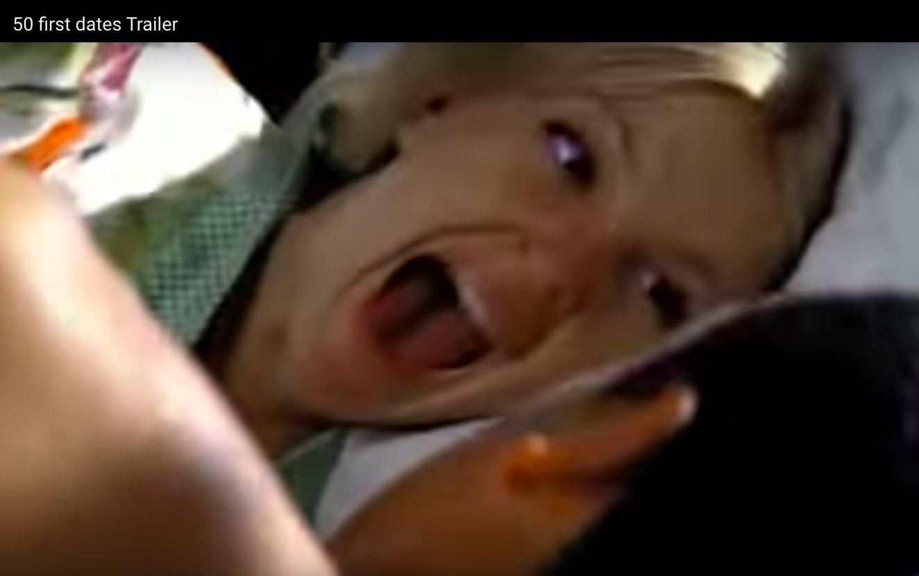
Let’s imagine that…
Henry Roth is a man afraid of commitment up until he meets the beautiful Lucy.
They hit it off and Henry think he's finally found the girl of his dreams,
until he discovers:
she has short-term memory loss and forgets him every next day.

Slide 9
Index
Definition of Transfer Learning
Transductive vs Inductive learning – taxonomy
- Self-taught learning
- Multi-task learning
- Sample selection Bias
- Unsupervised learning
- Negative transfer
3. Conclusions

Slide 10
Transfer learning
What we do every day…
The origin of Transfer Learning:
how individuals transfer in one context to another context that share similar characteristics.

Slide 11
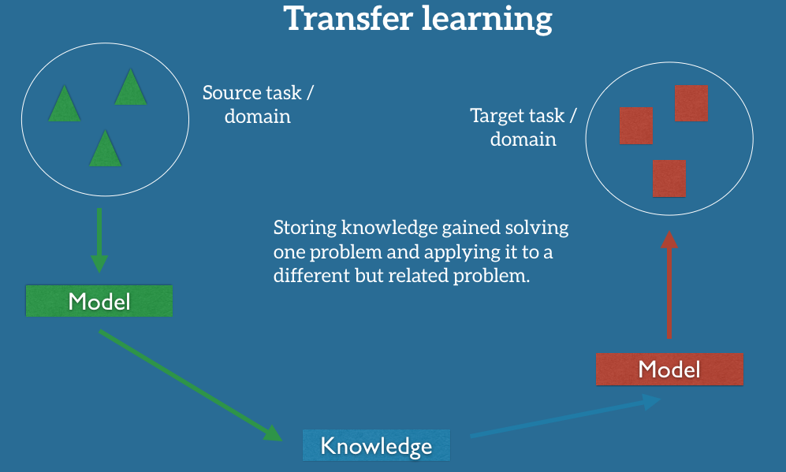
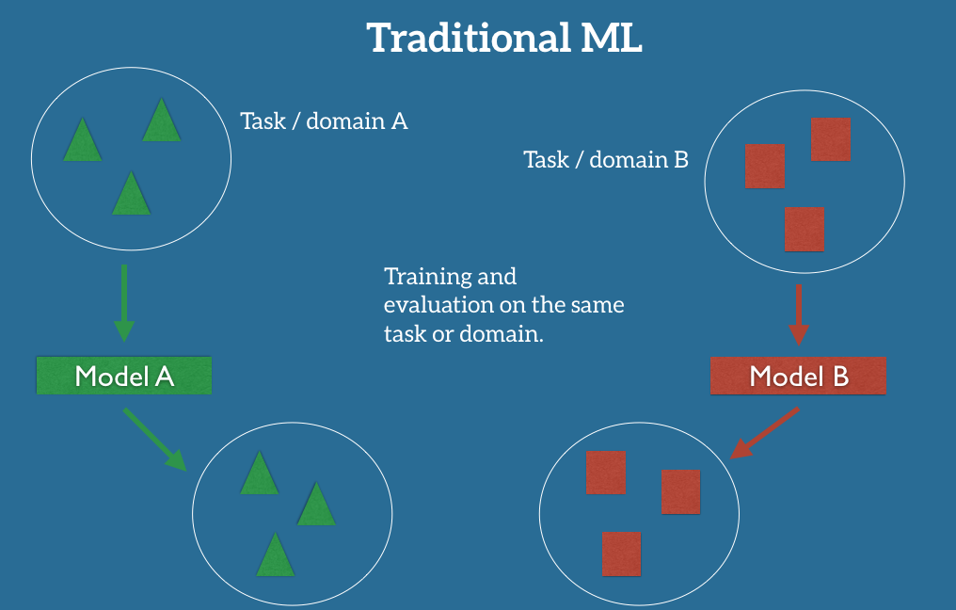
What is Transfer learning?
Transfer Learning (TL):
The ability of a system to recognize and apply knowledge and skills learned in previous tasks to novel tasks (in new domains).
https://ruder.io/transfer-learning/index.html#whatistransferlearning
Notes:
In practice, however, we often experience a deterioration or collapse in performance as the model has inherited the bias of its training data and does not know how to generalize to the new domain.

Slide 12
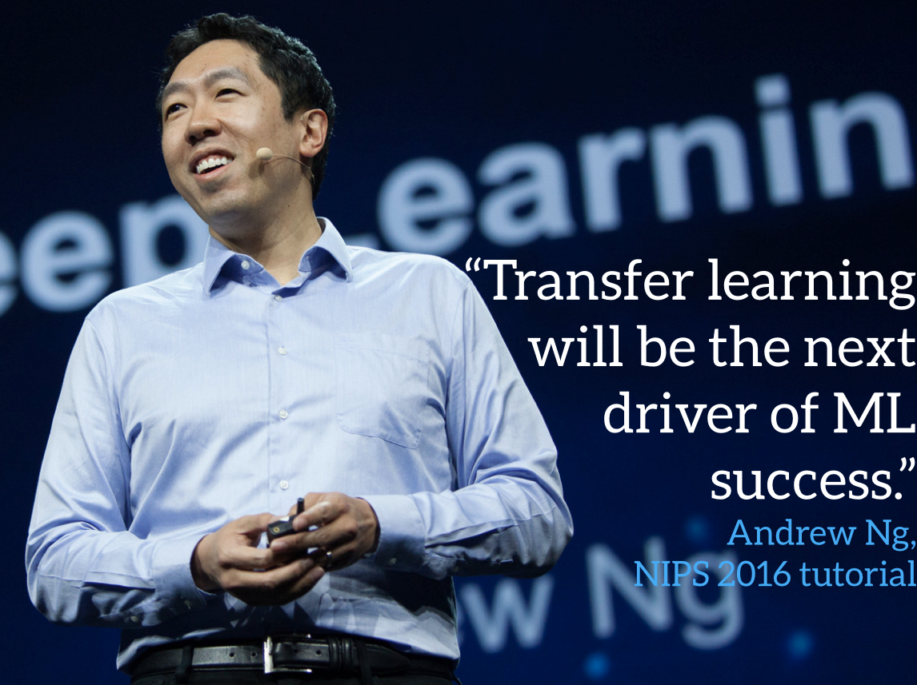
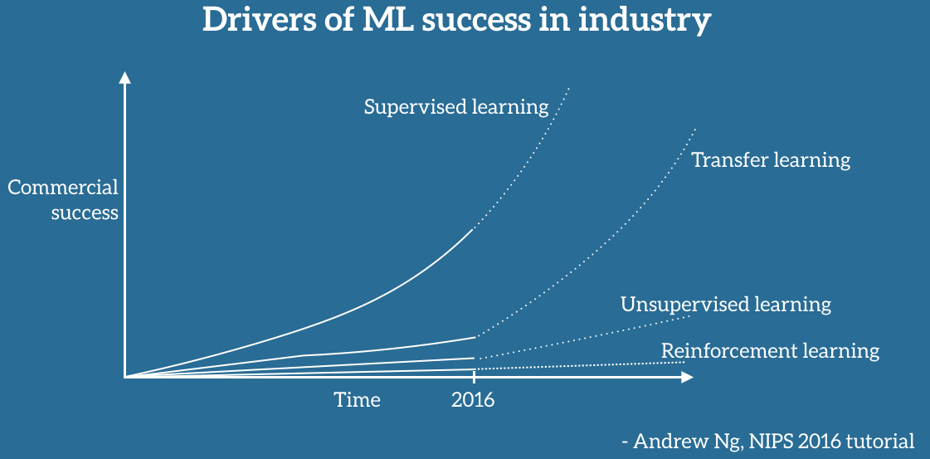
Why Transfer Learning Now?
Andrew Ng, chief scientist at Baidu and professor at Stanford
https://ruder.io/transfer-learning/index.html#fn44
Notes:
Andrew Ng, chief scientist at Baidu and professor at Stanford, said during his widely popular NIPS 2016 tutorial that transfer learning will be -- after supervised learning -- the next driver of ML commercial success.
According to Andrew Ng, transfer learning will become a key driver of Machine Learning success in industry.

Slide 13
Why do we need Transfer Learning?
Successful models are immensely data-hungry relying on huge amounts of labeled data to achieve their performance.
A model is asked to behave in a new situation on tasks that not exactly it was trained for.
https://ruder.io/transfer-learning/index.html#fn44

Slide 14
Why now is the time for Transfer Learning?
Availability of well working models
ResNet achieveing superhuman performance on recognizing objects
Google's Smart Reply [2] automatically handles 10% of all mobile responses;
speech recognition error has consistently dropped and is more accurate than typing [3];
we can automatically identify skin cancer as well as dermatologists;
Google's NMT system [4] is used in production for more than 10 language pairs; Baidu
https://ruder.io/transfer-learning/index.html#fn44
Notes:
The current use of machine learning in industry is characterised by a dichotomy:
On the one hand, over the course of the last years, we have obtained the ability to train more and more accurate models. We are now at the stage that for many tasks, state-of-the-art models have reached a level where their performance is so good that it is no longer a hindrance for users. How good? The newest residual networks [1] on ImageNet achieve superhuman performance at recognising objects; Google's Smart Reply [2] automatically handles 10% of all mobile responses; speech recognition error has consistently dropped and is more accurate than typing [3]; we can automatically identify skin cancer as well as dermatologists; Google's NMT system [4] is used in production for more than 10 language pairs; Baidu can generate realistic sounding speech in real-time; the list goes on and on. This level of maturity has allowed the large-scale deployment of these models to millions of users and has enabled widespread adoption.
At the same time, when applying a machine learning model in the wild, it is faced with a myriad of conditions which the model has never seen before and does not know how to deal with; each client and every user has their own preferences, possesses or generates data that is different than the data used for training; a model is asked to perform many tasks that are related to but not the same as the task it was trained for. In all of these situations, our current state-of-the-art models, despite exhibiting human-level or even super-human performance on the task and domain they were trained on, suffer a significant loss in performance or even break down completely.

Slide 15
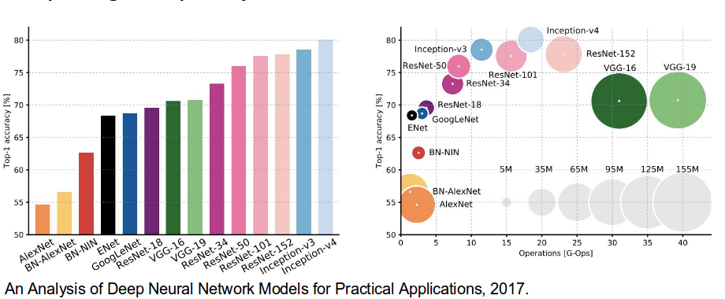
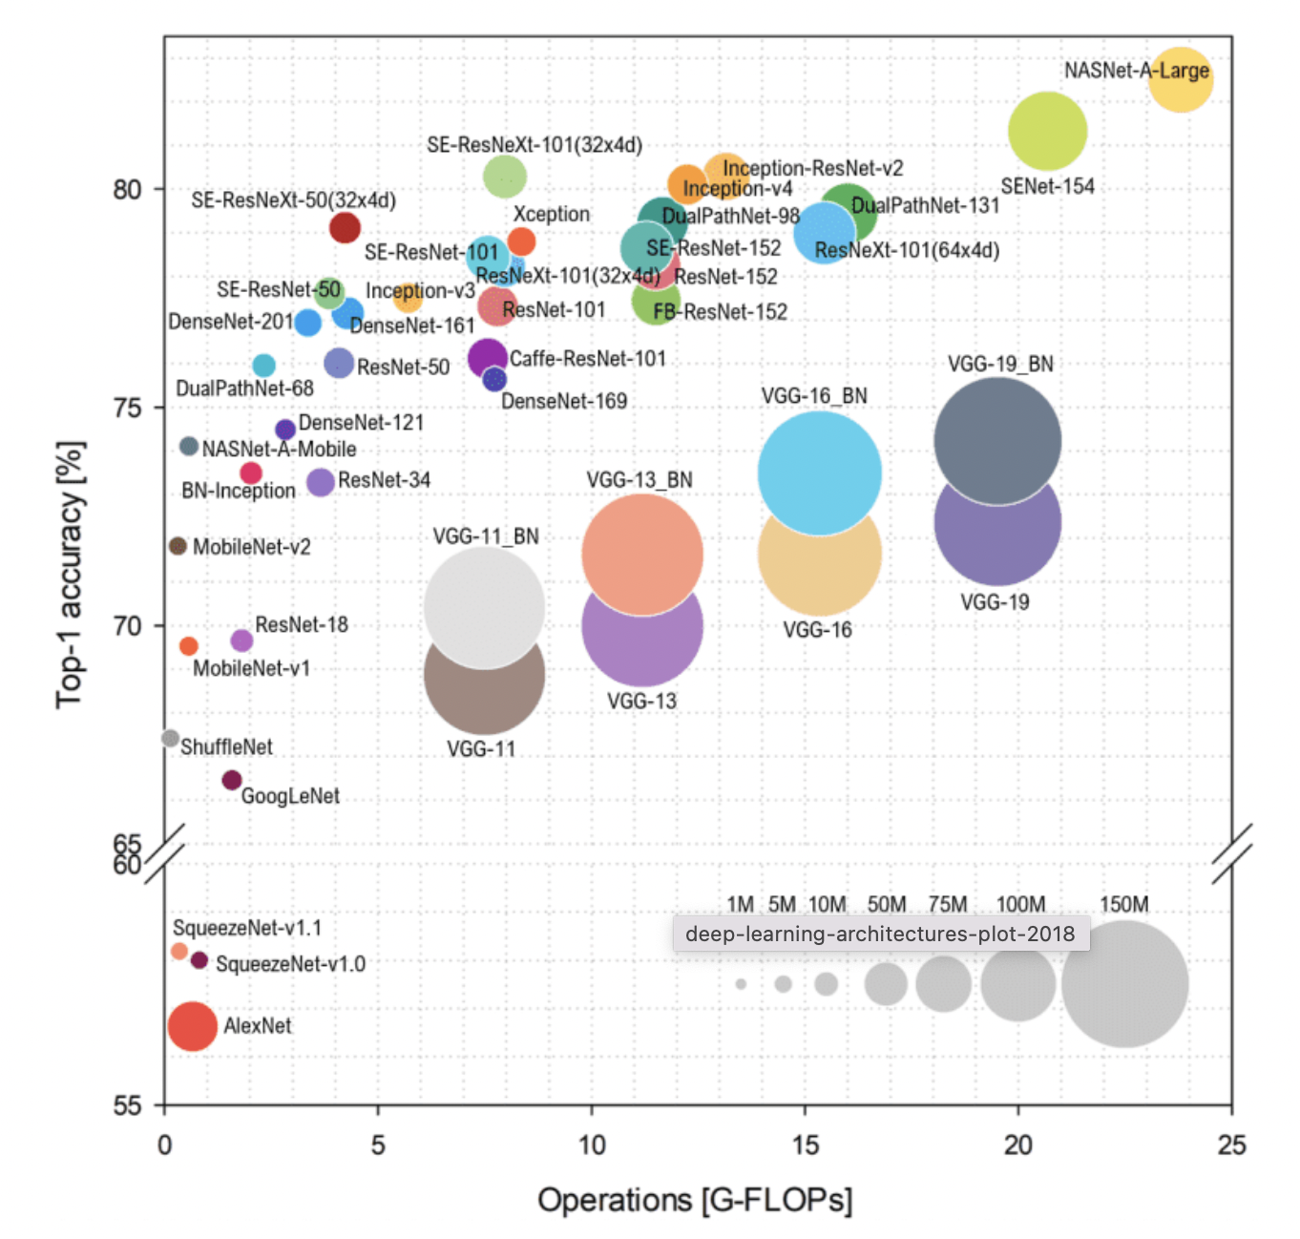
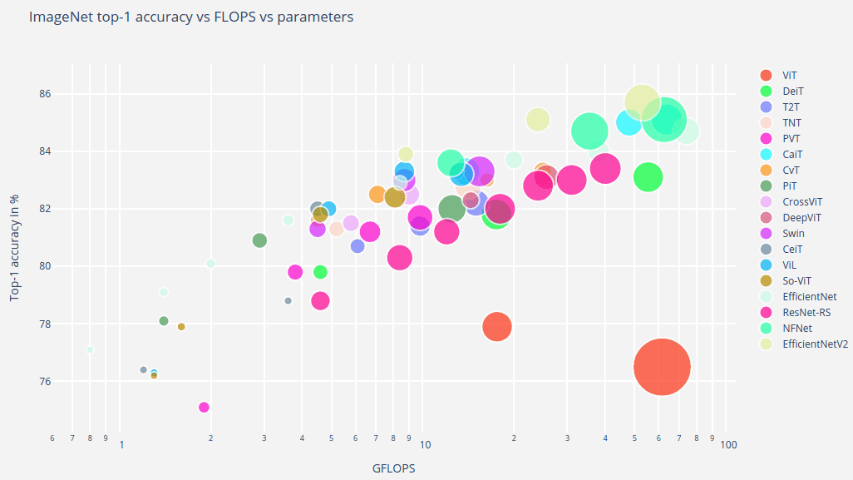
Analysis of CNNs
Millions of parameters!!!
The process of training a CNN consists of training all hyperparameters: convolutional matrices and weights of the fully connected layers.
Notes:
https://medium.com/analytics-vidhya/cnns-architectures-lenet-alexnet-vgg-googlenet-resnet-and-more-666091488df5

Slide 16
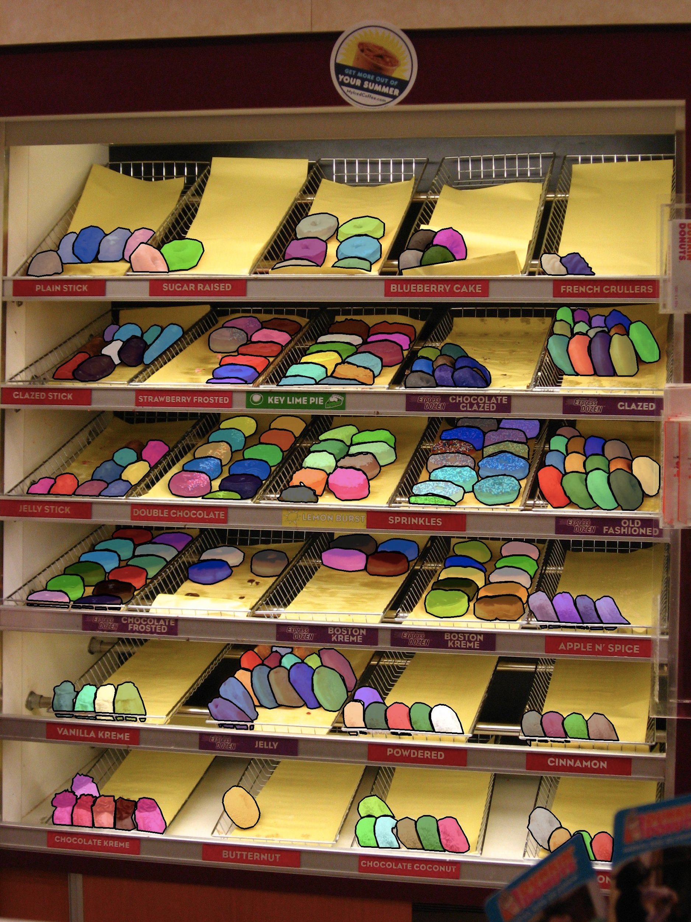
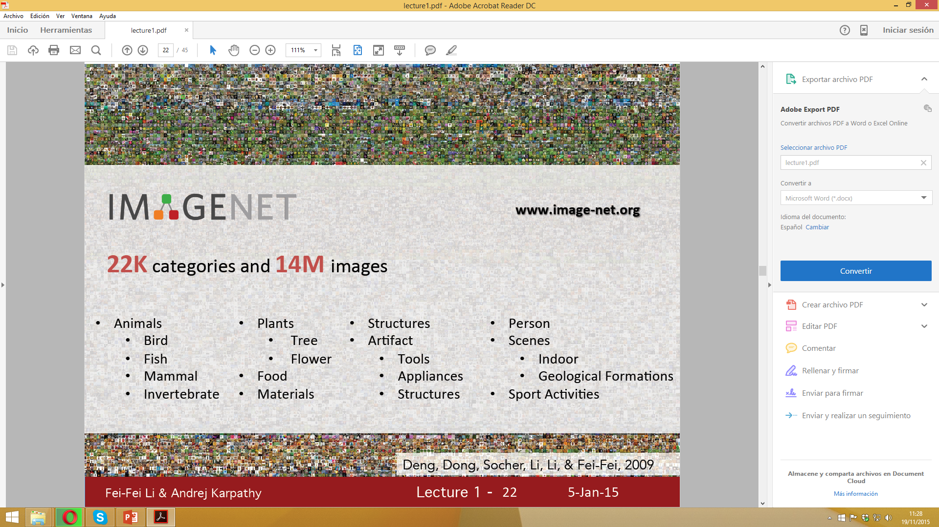
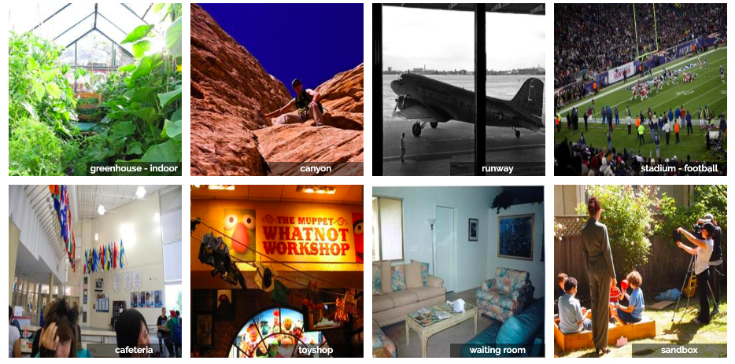
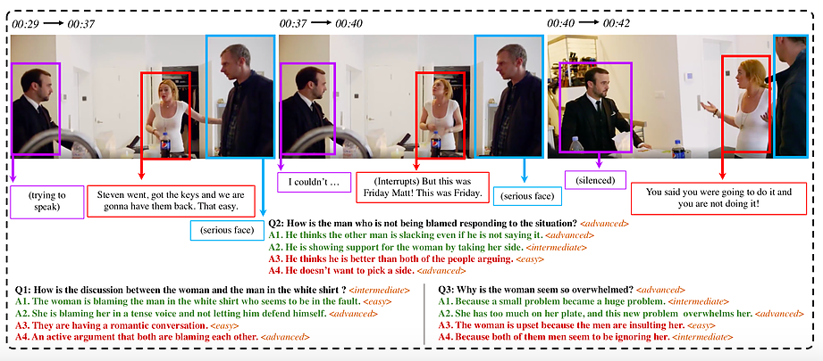
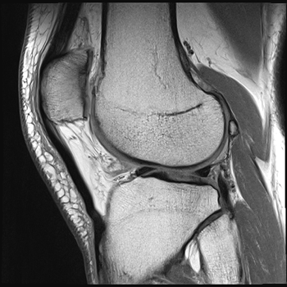
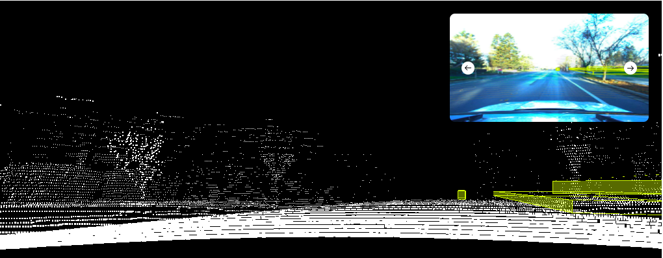
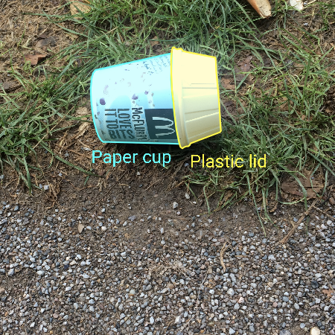
Deep Learning Datasets
LVIS Challenge: 2.2M masks, 16K images
Places2: 10M images
Lyft Level 5
TACO: Waste in the wild
SocialIQ
FastMRI
https://www.datasetlist.com
Notes:
https://www.datasetlist.com

Slide 17
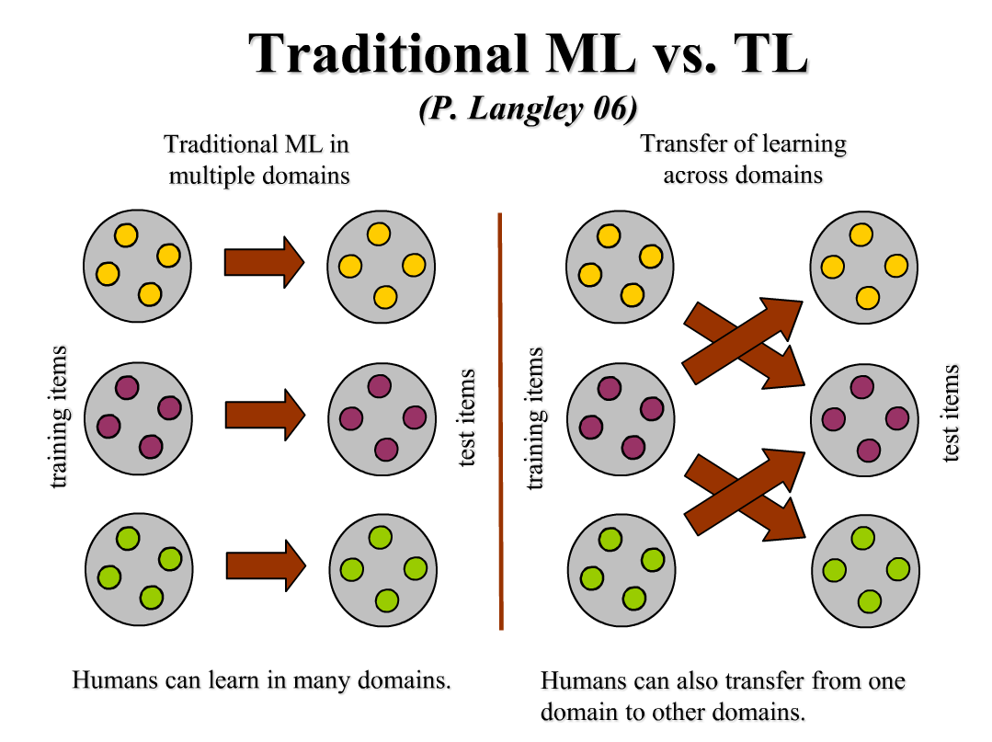
Traditional ML vs. TL
Pan, S. J., & Yang, Q. (2009). A Survey on Transfer Learning. IEEE Trans. KDE, 22(10), 1345-1359

Slide 18
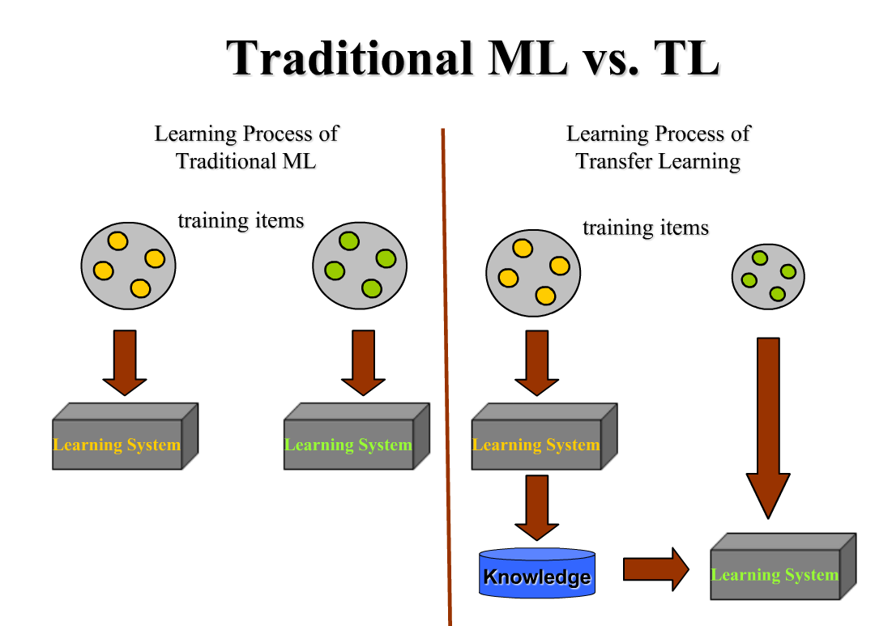
Traditional ML vs. TL
Pan, S. J., & Yang, Q. (2009). A Survey on Transfer Learning. IEEE Trans. KDE, 22(10), 1345-1359

Slide 19
Why Transfer Learning?
In many domains:
labeled data are in short supply,
the learning process is time consuming,
the calibration effort is very expensive.
Pan, S. J., & Yang, Q. (2009). A survey on transfer learning. IEEE Trans. KDE, 22(10), 1345-1359

Slide 20
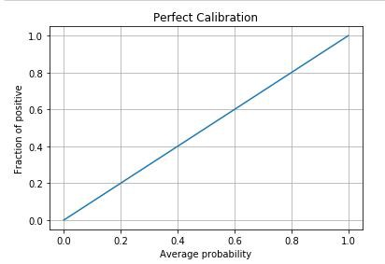
What is model calibration?
In calibration we try to improve our model such that the distribution and behaviour of the probability predicted is similar to the distribution and behaviour of probability observed in training data.
Suppose we have 10 points in the sample where 7 belongs to positive class and 3 belongs to negative class. Then fraction of positive points is 0.7 (observed probability).
So there is 70% probability that a point in this sample will get a class label as positive.
Now we will take the average of probability estimates (predicted probability) predicted by the model.
We expect this average to be around 0.7.
Perfectly calibrated model
Notes:
Suppose we have a small sample of data points. Say we have 10 points in the sample and out of these 10 points 7 belongs to positive class and 3 belongs to negative class. Then fraction of positive points is 0.7(observed probability). This means that there is 70% probability that a point in this sample will get a class label as positive. Now we will take the average of probability estimates (predicted probability) predicted by the model. We expect this average to be around 0.7 . If this value is far from 0.7 then our model is not calibrated. Following graph shows the ideal case when the model is perfectly calibrated. We don’t get this plot in practice.

Slide 21
Why Transfer Learning?
How to extract knowledge learnt from related domains to help learning in a target domain with a few labeled data?
How to extract knowledge learnt from related domains to speed up learning in a target domain?
Transfer learning techniques may help!
Pan, S. J., & Yang, Q. (2009). A survey on transfer learning. IEEE Trans. KDE, 22(10), 1345-1359

Slide 22
Definition of Transfer Learning
Given a source domain D_{S}, a corresponding source task T_{S}, as well as a target domain D_{T} and a target T_{T}.
the objective of transfer learning now is to learn
the target conditional probability distribution P(Y_{T}|X_{T}) in D_{T}
with the information gained from D_{S} and T_{S} where D_{S} ≠ D_{T} or T_{S} ≠ T_{T}.
In most cases, a limited number of labeled target examples, which is exponentially smaller than the number of labeled source examples are assumed to be available.

Slide 23
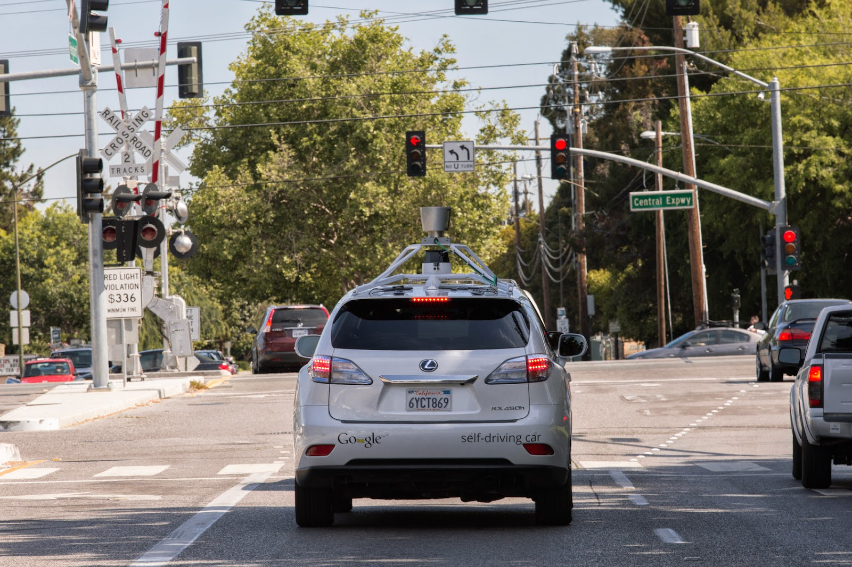
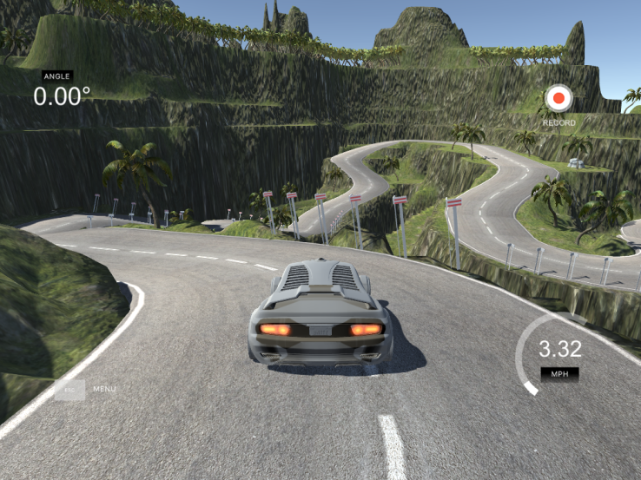
Learning from simulations
For many applications, gathering data and training a model in the real world is either expensive, time-consuming, or simply too dangerous.
Learning from a simulation and applying the acquired knowledge to the real world is an instance of transfer learning:
the conditional probability distributions between simulation and real wold might be different as the simulation is not able to fully replicate all reactions in the real world.
Pan, S. J., & Yang, Q. (2009). A survey on transfer learning. IEEE Trans. KDE, 22(10), 1345-1359
Notes:
For many machine learning applications that rely on hardware for interaction, gathering data and training a model in te real world is either expensive, time-consuming, or simply too dangerous. It is thus advisable to gather data in some other, less risky way.
Learning from a simulation and applying the acquired knowledge to the real world is an instance of transfer learning scenario 2, as the feature spaces between source and target domain are the same (both generally rely on pixels), but the marginal probability distributions between simulation and reality are different, i.e. objects in the simulation and the source look different, although this difference diminishes as simulations get more realistic.
the conditional probability distributions between simulation and real wold might be different as the simulation is not able to fully replicate all reactions in the real world, e.g. a physics engine can not completely mimic the complex interactions of real-world objects.
Simulation is the preferred tool for this and is used towards enabling many advanced ML systems in the real world. Learning from a simulation and applying the acquired knowledge to the real world is an instance of transfer learning scenario 2, as the feature spaces between source and target domain are the same (both generally rely on pixels), but the marginal probability distributions between simulation and reality are different, i.e. objects in the simulation and the source look different, although this difference diminishes as simulations get more realistic. At the same time, the conditional probability distributions between simulation and real wold might be different as the simulation is not able to fully replicate all reactions in the real world, e.g. a physics engine can not completely mimic the complex interactions of real-world objects.
Learning from simulations has the benefit of making data gathering easy as objects can be easily bounded and analyzed, while simultaneously enabling fast training, as learning can be parallelized across multiple instances. Consequently, it is a prerequisite for large-scale machine learning projects that need to interact with the real world, such as self-driving cars (Figure 6). According to Zhaoyin Jia, Google's self-driving car tech lead, "Simulation is essential if you really want to do a self-driving car". Udacity has open-sourced the simulator it uses for teaching its self-driving car engineer nanodegree, which can be seen in Figure 7 and OpenAI's Universe will potentially allows to train a self-driving car using GTA 5 or other video games.

Slide 24
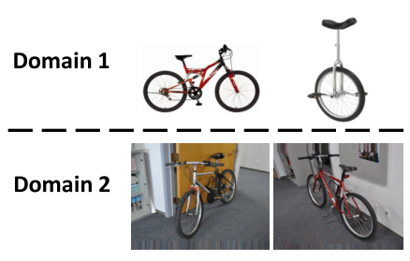
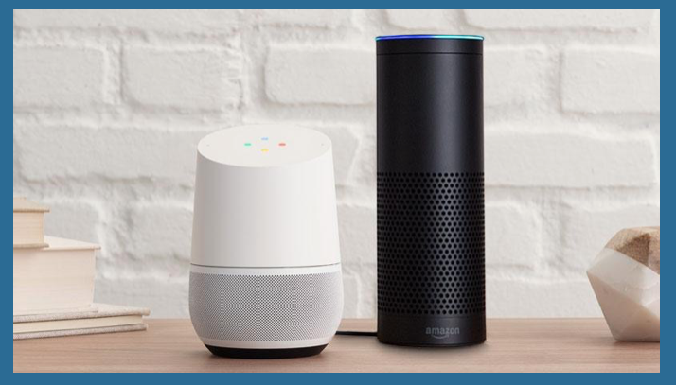
Domain adaptation
Note!:
Even of the training and the test data look the same, the training data could contain a bias imperceptible to humans but which the model will exploit to overfit in the training data.
Notes:
Finally, while the above challenges deal with general text or image types, problems are amplified if we look at domains that pertain to individual or groups of users: Consider the case of automatic speech recognition (ASR). Speech is poised to become the next big platform, with 50% of all our searches predicted to be performed by voice by 2020. Most ASR systems are evaluated traditionally on the Switchboard dataset, which comprises 500 speakers. Most people with a standard accent are thus fortunate, while immigrants, people with non-standard accents, people with a speech impediment, or children have trouble being understood. Now more than ever do we need systems that are able to adapt to individual users and minorities to ensure that everyone's voice is heard.

Slide 25
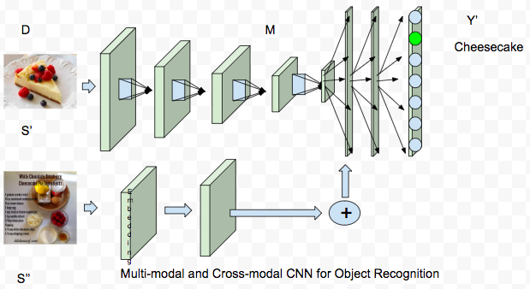
Transfer Learning

Slide 26
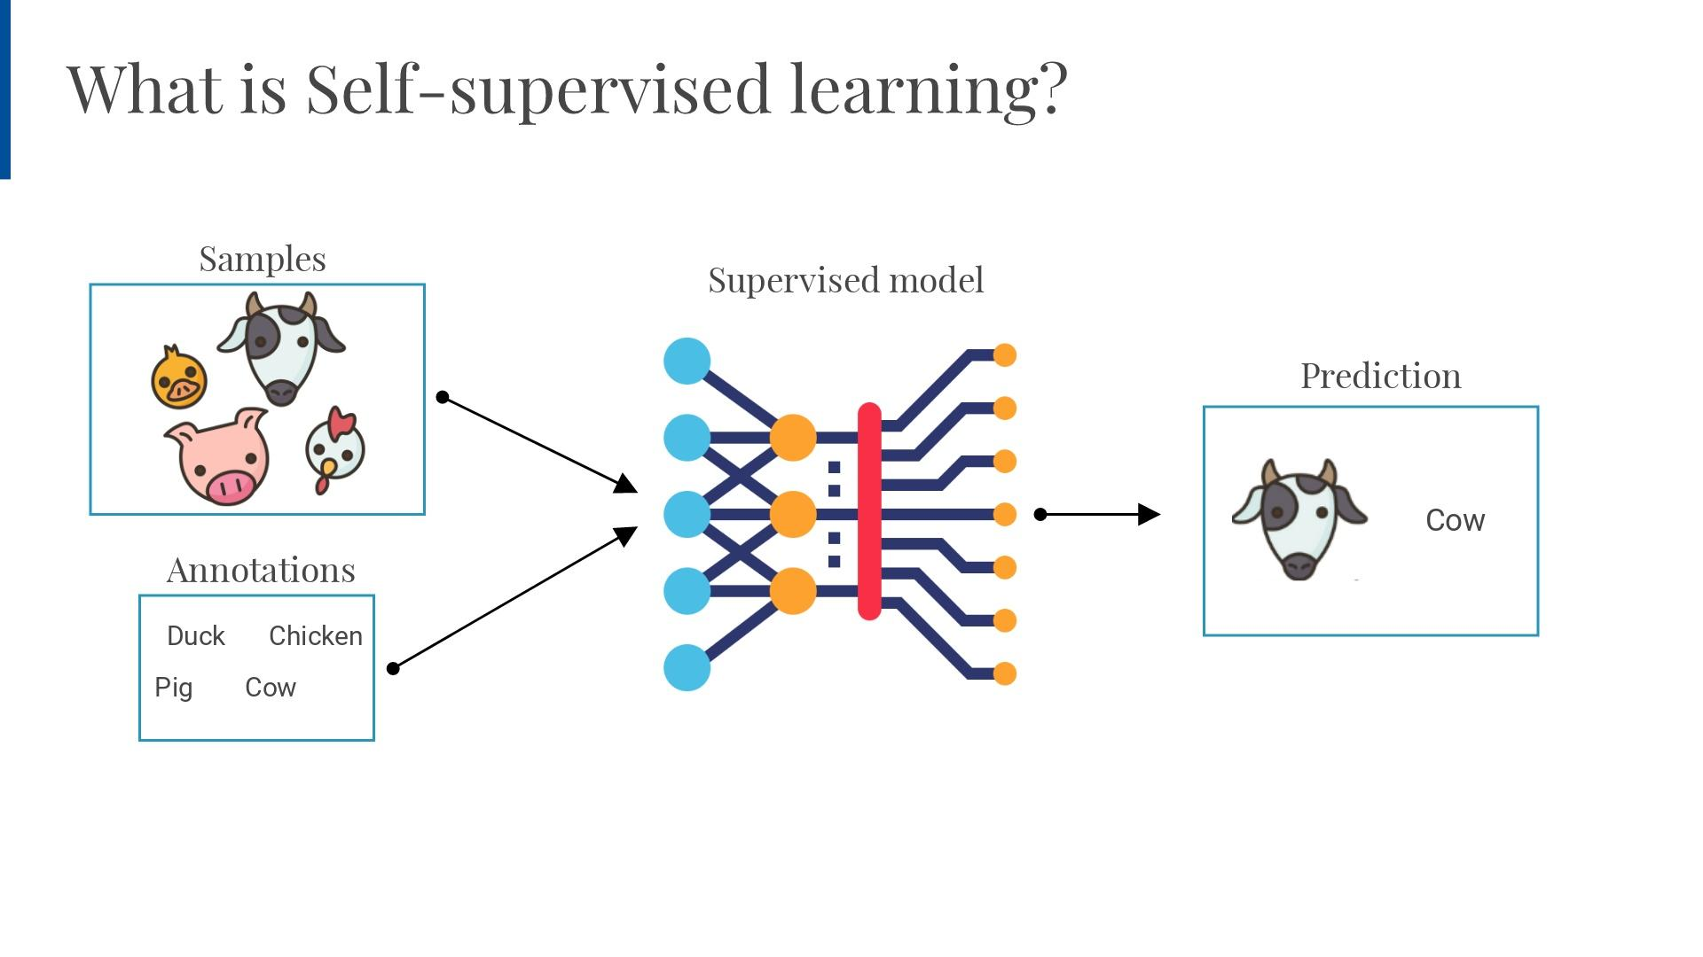
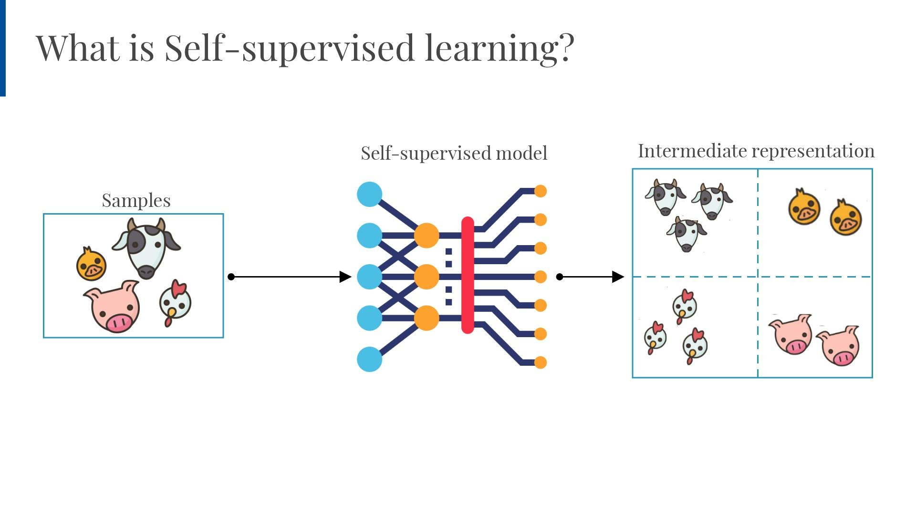
Supervised vs unsupervised learning

Slide 27
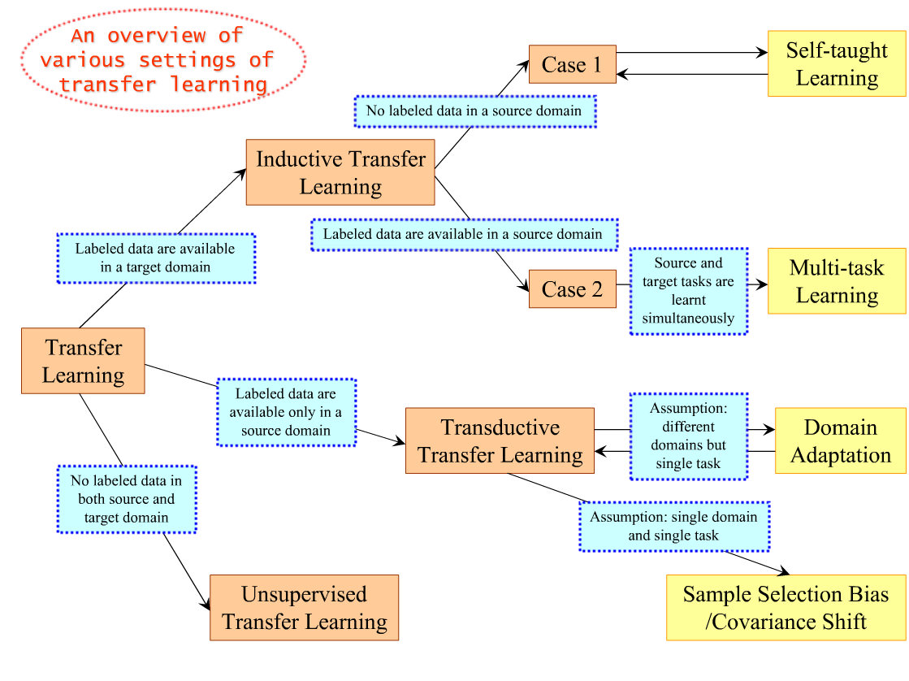
Taxonomy according to available labels
Fine-tunning

Slide 28
Index
Transductive vs Inductive learning
- Multi-task learning
- Domain adaptation
- Sample selection Bias
- Unsupervised learning
- Negative transfer
- Self-taught learning

Slide 29
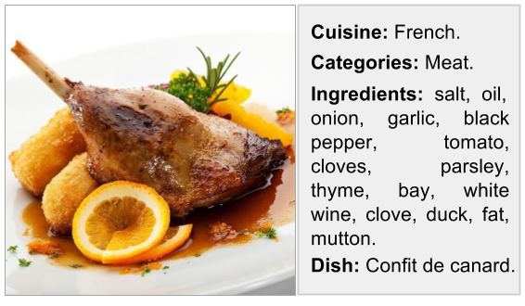
Multi-Task Learning (MTL)
Learning multiple objectives from a shared representation
- Efficiency and prediction accuracy.
Crucial importance in systems where long computation run-time is prohibitive
- Combining all tasks reduces computation.
Inductive knowledge transfer
- Generalization by sharing the domain information between complimentary tasks.
Notes:
Multi-task learning aims to improve learning efficiency and prediction accuracy for for each task,
when compared to training the models separately [18, 19]. It can be considered an approach to
inductive knowledge transfer which improves generalisation by sharing the domain information
between complimentary tasks. It does this by using a shared representation to learn multiple tasks –
what is learned from one task can help other tasks be learned better [1].

Slide 30
Multi-Task Learning
Input: A lot of labeled data in a source domain and the target domain that coincide.
Goal: Classifying the target and source domain data simultaneously .
Assumption: The source domain and target domain data share some common features, which can help classifying sharing knowledge.
Main Idea: To train simultaneously both tasks.
Pan, S. J., & Yang, Q. (2009). A survey on transfer learning. IEEE Trans. KDE, 22(10), 1345-1359

Slide 31
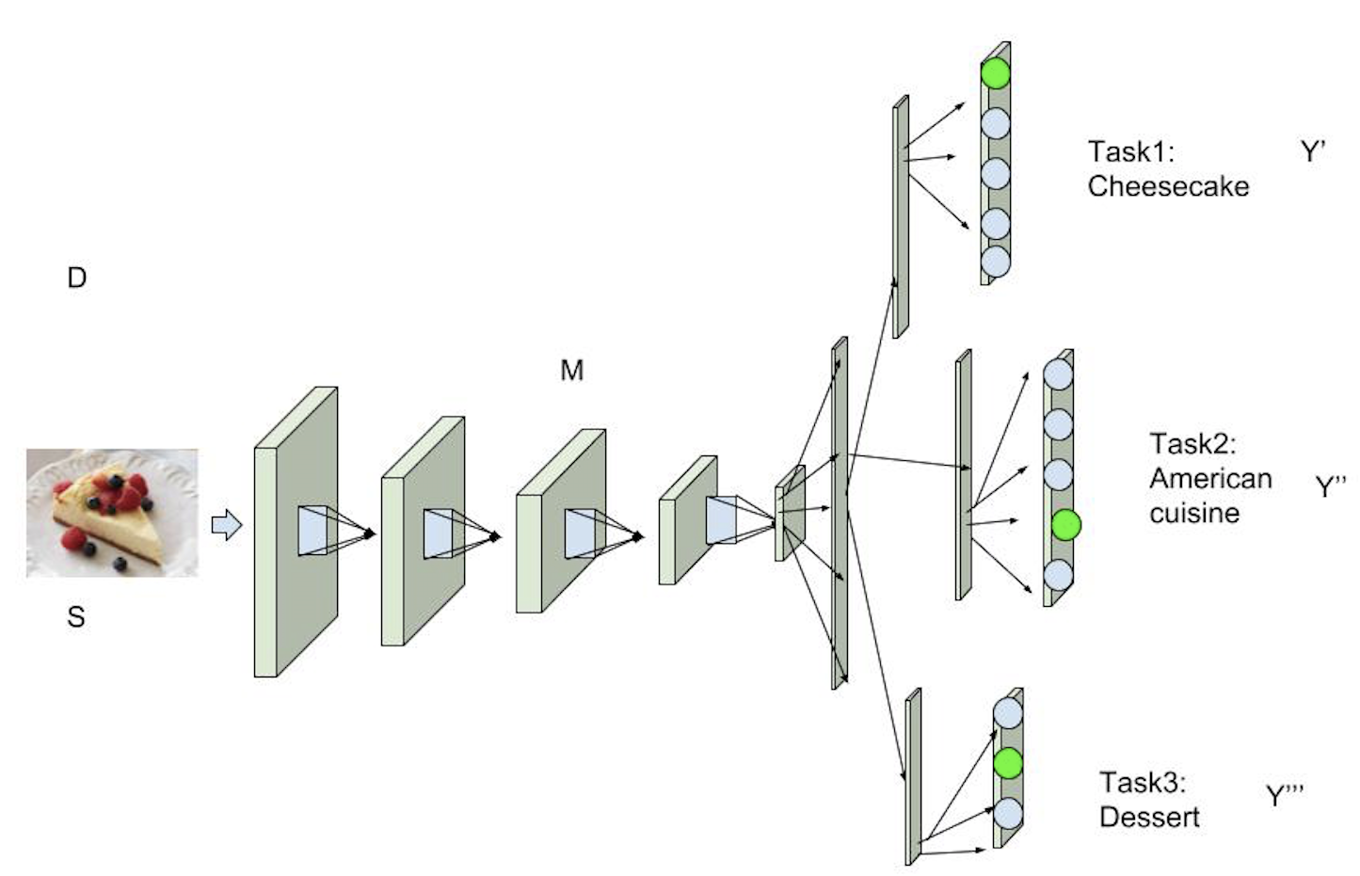
Multi-Task Learning

Slide 32
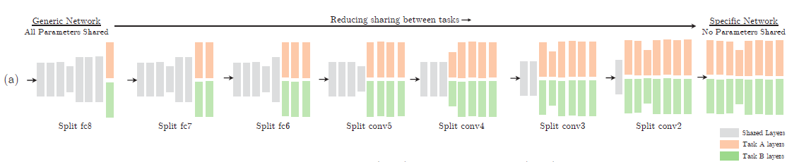
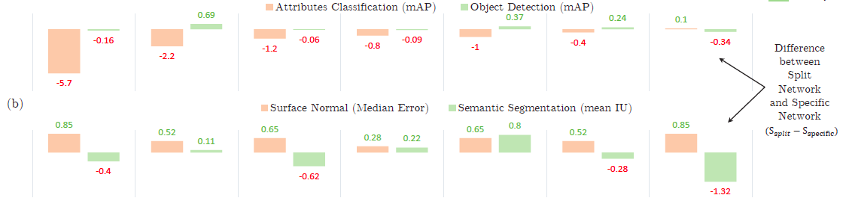
MTF possible architectures
I. Misra, A. Shrivastava A. Gupta, M. Hebert, “Cross-stitch Networks for Multi-task Learning”, CVPR’2016

Slide 33
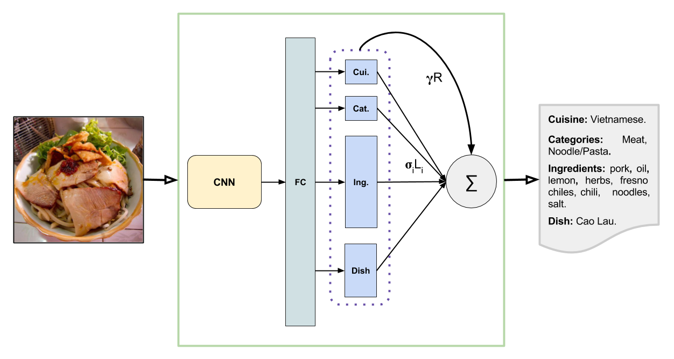
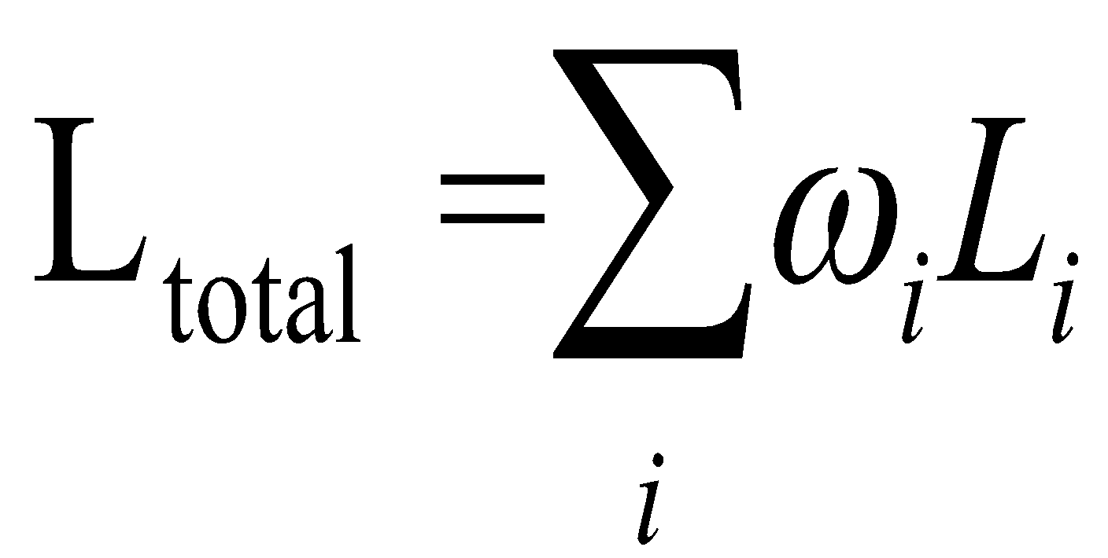
Loss function in the MTL

Slide 34
How to define the importance of each task?
Weighted uniformly the losses.
Manually tuned the losses.
Dynamic weighted of the losses.
The main task is fixed and weights are learned for each side-task ([1]).
Weight the tasks according to the homoscedastic uncertainty ([2]).
[1] X. Yin and X. Liu. Multi-task convolutional neural network for face recognition.
[2] A. Kendall, Y. Gal, and R. Cipolla. Multi-task learning using uncertainty to weigh losses for scene geometry and semantics.

Slide 35
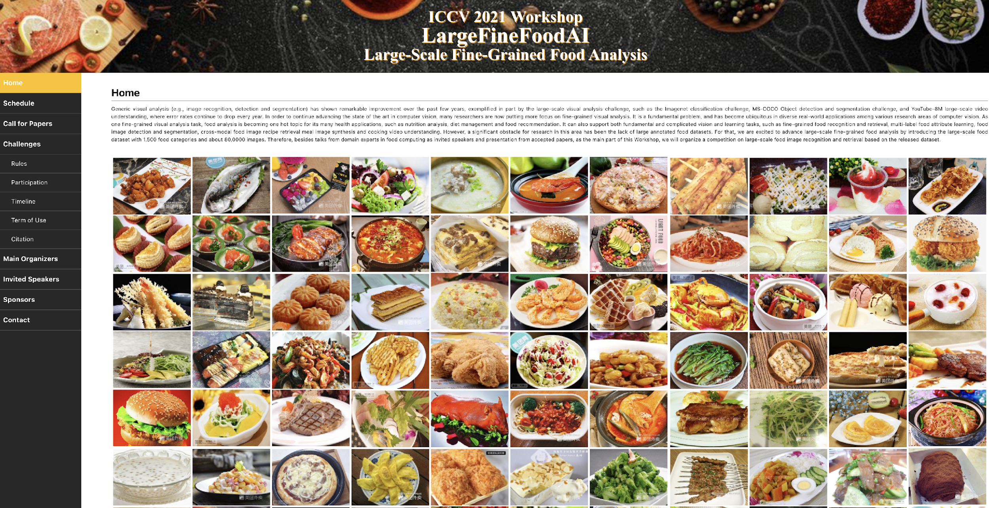
Example: Food datasets
LargeFineFoodAI dataset 1,000 fine-grained food categories and over 50,000 images.
Notes:
We are proving that completing our proposals with transformers we can come up with 90% of top1 food recognition and 48% of food segmentation precision,

Slide 36
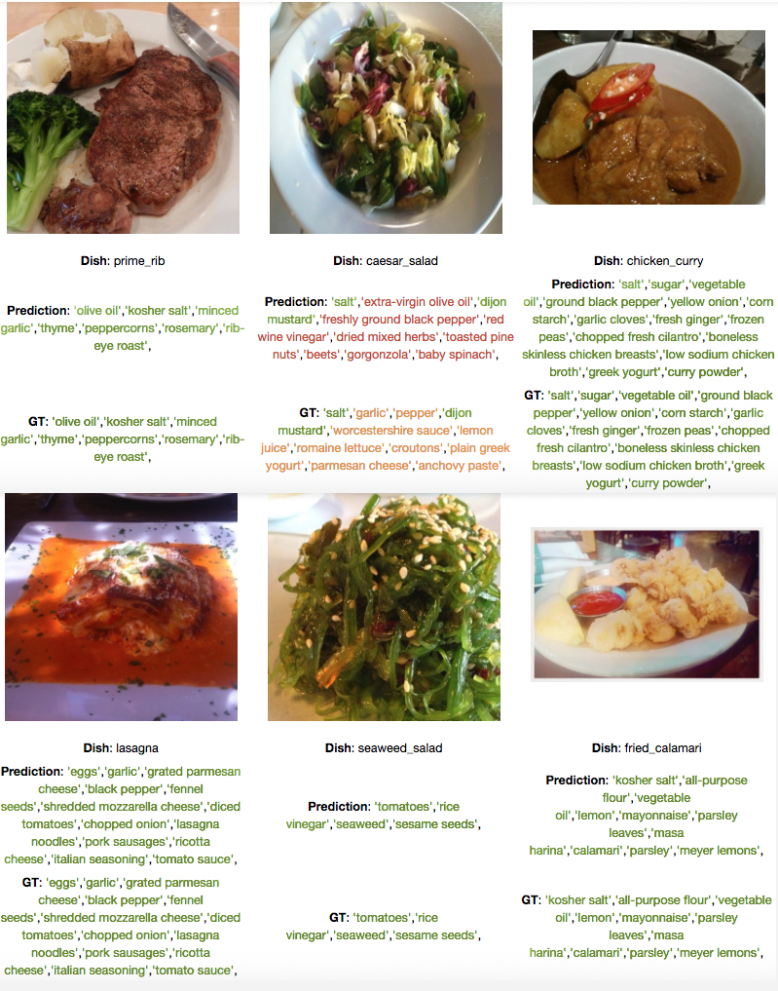
Food ingredients recognition
Food category and class recognition

Slide 37
Index
Definition of Transfer Learning
Transductive vs Inductive learning – taxonomy
- Multi-task learning
- Domain adaptation
- Sample selection Bias
- Unsupervised learning
- Negative transfer
- Self-taught learning
3. Conclusions

Slide 38
Transductive Transfer Learning: Domain Adaptation
Input: A lot of labeled data in D_{S} and only unlabeled data in D_{T}.
Assumption: Single task across domains, which means P(Y_{S}|X_{S}) and P(Y_{T}|X_{T}) are the same while P(X_{S}) and P(X_{T}) may be different.
Output: A common representation between D_{S} and D_{T} and a model on the new representation for use in D_{T}.
Main Idea: Find a “good” feature representation that reduces the “distance” between both domains.
Pan, S. J., & Yang, Q. (2009). A survey on transfer learning. IEEE Trans. KDE, 22(10), 1345-1359

Slide 39
Making representations more similar
To improve transferability, look for representations as similar as possible btw both domains.
The model should not take into account domain-specific characteristics that may hinder transfer but the commonalities between the domains.
Apply as
Pre-processing step to the data representatons, or
Encourage representations of the domains to be more similar to each other.
Notes:
In order to improve the transferability of the learned representations from the source to the target domain, we would like the representations between the two domains to be as similar as possible so that the model does not take into account domain-specific characteristics that may hinder transfer but the commonalities between the domains.
Rather than just letting our autoencoder learn some representation, we can thus actively encourage the representations of both domains to be more similar to each other. We can apply this as a pre-processing step directly to the representations of our data [25], [26] and can then use the new representations for training. We can also encourage the representations of the domains in our model to be more similar to each other [27], [28].

Slide 40
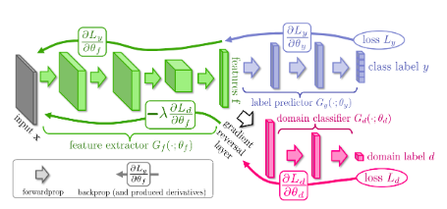
Confusing domains
A way to ensure similarity between the representations of both domains:
add another objective to an existing model that encourages it to confuse the two domains.
This domain confusion loss is a regular classification loss where the model tries to predict the domain of the input example.
The difference to a regular loss: the gradients that flow from the loss to the rest of the network are reversed.
Notes:
Another way to ensure similarity between the representations of both domains that has recently become more popular is to add another objective to an existing model that encourages it to confuse the two domains [29], [30]. This domain confusion loss is a regular classification loss where the model tries to predict the domain of the input example. The difference to a regular loss, however, is that gradients that flow from the loss to the rest of the network are reversed, as can be seen in Figure 17.

Slide 41
Confusing domains
Hypothesis: for effective domain transfer to be achieved, predictions must be made based on features that cannot discriminate between the training (source) and test (target) domains.
The proposed architecture includes:
- a deep feature extractor (green) and a deep label predictor (blue), which together form a standard feed-forward architecture.
Unsupervised domain adaptation is achieved by adding a domain classifier (red) connected to the feature extractor via a Gradient Reversal Layer that multiplies the gradient by a certain negative constant during the backpropagation-based training.
The training minimizes:
the label prediction loss (for source examples) and
the domain classication loss (for all samples).
Notes:
The proposed architecture includes a deep feature extractor (green) and a deep
label predictor (blue), which together form a standard feed-forward architecture.
Unsupervised domain adaptation is achieved by adding a domain classier (red)
connected to the feature extractor via a gradient reversal layer that multiplies
the gradient by a certain negative constant during the backpropagation-based
training. Otherwise, the training proceeds standardly and minimizes the label
prediction loss (for source examples) and the domain classication loss (for all
samples). Gradient reversal ensures that the feature distributions over the two
domains are made similar (as indistinguishable as possible for the domain classi-
er), thus resulting in the domain-invariant features.
Gradient reversal ensures that the feature distributions over the two domains are made similar (as indistinguishable as possible for the domain classi- er), thus resulting in the domain-invariant features.

Slide 42
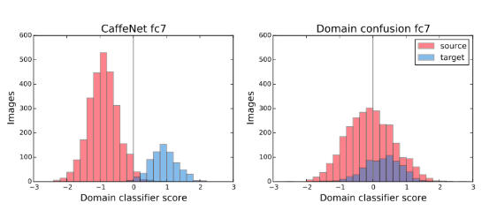
Confusing domains
While a model trained only with the regular objective is to be clearly able to separate domains based on its learned representation, a model whose objective has been augmented with the domain confusion term is unable to do so.
Domain classifier score of a regular and a domain confusion model (Tzeng et al, 2015)
Notes:
Instead of learning to minimize the error of the domain classification loss, the gradient reversal layer causes the model to maximize the error. In practice, this means that the model learns representations that allow it to minimize its original objective, while not allowing it to differentiate between the two domains, which is beneficial for knowledge transfer. While a model trained only with the regular objective is shown in Figure 18 to be clearly able to separate domains based on its learned representation, a model whose objective has been augmented with the domain confusion term is unable to do so.

Slide 43
Domain Separation Networks
Existing approaches for domain adaptation:
Map a domain to another, or
Extract features invariant to both domains.
However, they ignore individual features of both domains.
Proposal: explicitly modelling what is unique help construct invariant features.
Bousmalis, K., Trigeorgis, G., Silberman, N., Krishnan, D., & Erhan, D. (2016). Domain Separation Networks. NIPS. ↩︎
Notes:
The cost of large scale data collection and annotation often makes the application
of machine learning algorithms to new tasks or datasets prohibitively expensive.
One approach circumventing this cost is training models on synthetic data where
annotations are provided automatically. Despite their appeal, such models often
fail to generalize from synthetic to real images, necessitating domain adaptation
algorithms to manipulate these models before they can be successfully applied.
Existing approaches focus either on mapping representations from one domain to
the other, or on learning to extract features that are invariant to the domain from
which they were extracted. However, by focusing only on creating a mapping
or shared representation between the two domains, they ignore the individual
characteristics of each domain. We hypothesize that explicitly modeling what is
unique to each domain can improve a model’s ability to extract domain-invariant
features. Inspired by work on private-shared component analysis, we explicitly
learn to extract image representations that are partitioned into two subspaces: one
component which is private to each domain and one which is shared across domains.
Our model is trained to not only perform the task we care about in the source
domain, but also to use the partitioned representation to reconstruct the images
from both domains. Our novel architecture results in a model that outperforms
the state-of-the-art on a range of unsupervised domain adaptation scenarios and
additionally produces visualizations of the private and shared representations
enabling interpretation of the domain adaptation process.

Slide 44
Domain Separation Networks
Hypothesis:
S & T differ mainly in terms of the low-level image features (illumination, colour) distributions but high-level parameters (objects, 3D pose) have similar distributions and the same label space.
Extract image representations partitioned into 2 subspaces:
Particular to each domain
Shared across domains.
Bousmalis, K., Trigeorgis, G., Silberman, N., Krishnan, D., & Erhan, D. (2016). Domain Separation Networks. NIPS. ↩︎
Notes:
The cost of large scale data collection and annotation often makes the application
of machine learning algorithms to new tasks or datasets prohibitively expensive.
One approach circumventing this cost is training models on synthetic data where
annotations are provided automatically. Despite their appeal, such models often
fail to generalize from synthetic to real images, necessitating domain adaptation
algorithms to manipulate these models before they can be successfully applied.
Existing approaches focus either on mapping representations from one domain to
the other, or on learning to extract features that are invariant to the domain from
which they were extracted. However, by focusing only on creating a mapping
or shared representation between the two domains, they ignore the individual
characteristics of each domain. We hypothesize that explicitly modeling what is
unique to each domain can improve a model’s ability to extract domain-invariant
features. Inspired by work on private-shared component analysis, we explicitly
learn to extract image representations that are partitioned into two subspaces: one
component which is private to each domain and one which is shared across domains.
Our model is trained to not only perform the task we care about in the source
domain, but also to use the partitioned representation to reconstruct the images
from both domains. Our novel architecture results in a model that outperforms
the state-of-the-art on a range of unsupervised domain adaptation scenarios and
additionally produces visualizations of the private and shared representations
enabling interpretation of the domain adaptation process.
We define “low-level” differences in the
distributions as those arising due to noise, resolution, illumination and color. “High-level” differences
relate to the number of classes, the types of objects, and geometric variations, such as 3D position
and pose. We assume that our source and target domains differ mainly in terms of the distribution of
low level image statistics and that they have high level parameters with similar distributions and the
same label space.

Slide 45
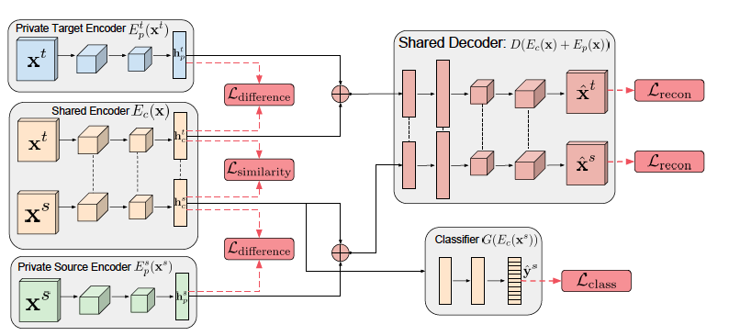
Domain Separation Networks
Cross-domain task
They assume the target domain is unlabelled, the loss is applied only to the source domain.
Bousmalis, K., Trigeorgis, G., Silberman, N., Krishnan, D., & Erhan, D. (2016). Domain Separation Networks. NIPS. ↩︎
Notes:
The cost of large scale data collection and annotation often makes the application
of machine learning algorithms to new tasks or datasets prohibitively expensive.
One approach circumventing this cost is training models on synthetic data where
annotations are provided automatically. Despite their appeal, such models often
fail to generalize from synthetic to real images, necessitating domain adaptation
algorithms to manipulate these models before they can be successfully applied.
Existing approaches focus either on mapping representations from one domain to
the other, or on learning to extract features that are invariant to the domain from
which they were extracted. However, by focusing only on creating a mapping
or shared representation between the two domains, they ignore the individual
characteristics of each domain. We hypothesize that explicitly modeling what is
unique to each domain can improve a model’s ability to extract domain-invariant
features. Inspired by work on private-shared component analysis, we explicitly
learn to extract image representations that are partitioned into two subspaces: one
component which is private to each domain and one which is shared across domains.
Our model is trained to not only perform the task we care about in the source
domain, but also to use the partitioned representation to reconstruct the images
from both domains. Our novel architecture results in a model that outperforms
the state-of-the-art on a range of unsupervised domain adaptation scenarios and
additionally produces visualizations of the private and shared representations
enabling interpretation of the domain adaptation process.
We define “low-level” differences in the
distributions as those arising due to noise, resolution, illumination and color. “High-level” differences
relate to the number of classes, the types of objects, and geometric variations, such as 3D position
and pose. We assume that our source and target domains differ mainly in terms of the distribution of
low level image statistics and that they have high level parameters with similar distributions and the
same label space.

Slide 46
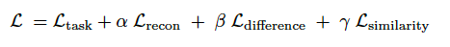
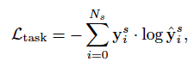
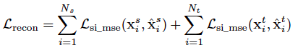
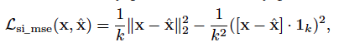
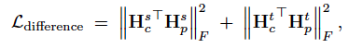
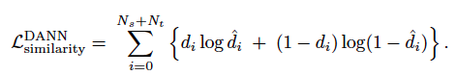
Domain Separation Networks
Final Loss function:
Classification loss
Assures data are reconstructed
Separates domain-specific vs domain-generic
Assures domain-generic features
where d_{i}∊{0; 1} is the ground truth domain label for sample i.

Slide 47
Index
Definition of Transfer Learning
Transductive vs Inductive learning – taxonomy
- Multi-task learning
- Domain adaptation
- Sample selection Bias
- Negative transfer
- Unsupervised learning
- Self-taught learning
3. Conclusions

Slide 48
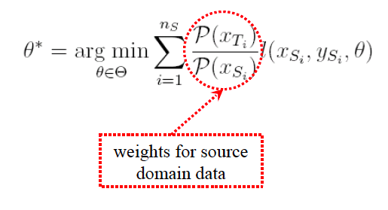
Sample Selection Bias
To correct sample selection bias:
How to estimate (P(X_{T})/P(X_{S}))?
One straightforward solution is to estimate P(X_{S}) and P(X_{T}), respectively.
Pan, S. J., & Yang, Q. (2009). A survey on transfer learning. IEEE Trans. KDE, 22(10), 1345-1359

Slide 49
Index
Definition of Transfer Learning
Transductive vs Inductive learning – taxonomy
- Domain adaptation
- Multi-task learning
- Sample selection Bias
- Unsupervised learning
- Negative transfer
- Self-taught learning
3. Conclusions

Slide 50
Negative Transfer
Most approaches to transfer learning assume transferring knowledge across domains be always positive.
However, in some cases, when two tasks are too dissimilar, brute-force transfer may even hurt the performance of the target task, which is called negative transfer.
Some researchers have studied how to measure relatedness among tasks.
How to design a mechanism to avoid negative transfer needs to be deeply studied theoretically and practically.
Pan, S. J., & Yang, Q. (2009). A survey on transfer learning. IEEE Trans. KDE, 22(10), 1345-1359

Slide 51

Transfer learning in Food Recognition
Notes:
So as in many other fields the first thing that comes to mind is to apply a fine tunning from a big image dataset like Imagenet. In this way we claim to leverage from the transfer learning capacity of the convolutional neural networks.
However when treating with very different domains the problem also can suffer negative transfer effect.
///
we propose to enhance the model with specially designed class priors for better recognition performance, which is used to tackle the covariate shift problem. The complexity and fine-grained nature of the food images, coupled with increased performance in multi-stage frameworks in other domains are primary reasons in our proposed methodology.

Slide 52
Negative transfer
Negative transfer: when source domain data and task contribute to reduced performance of learning in the target domain
Causes:
Domains are too dissimilar [RMKD05]
Tasks are not well-related [BH03], etc.
Similarity measures
Cosine similarity
Kullback-Leibler divergence
Jensen-Shannon divergence
Maximum Mean Discrepancy [BGR+02], etc.
Notes:
Negative transfer occurs usually when source data and task contribute to reduced perfformance of learning in the target domain. And the causes can be different: like dissimilar domains or not related tasks.
Different authors apply different similarity measures in order to compare the domains and predict the positive transfer,
&&&&&&&&
It has to be also noted that
TL does not always result in improvements. When weights are transferred from
similar domains, the learning of layers is faster and more accurate, whereas,
when the two domains are dissimilar, the learning could give inaccurate results,
known as Negative transfer [10,62]. However, there are a lot of open questions
regarding when negative transfer appears and how to avoid it [44]. A typical
heuristic solution to avoid negative transfer is to train only on samples that are
nearer to the target domain and avoid those samples that are far away from
the source domain [46]. Choice of positive samples thus becomes an important
aspect. However, there is no existing mechanism to determine if the particular
sample would result in positive or negative transfer [44].

Slide 53



Single- vs Multi-Label FR
Food-101 Food-201 our Combo-plates
Single-Label Recognition always has better performance than Multi-label Rec.
Most public datasets for FR are single-label.
However, we used to eat multiple food (so real FR should be a multi-label FR).
Notes:
Such a negative transfer occurs when we try to fine-tune a multilabel food recognition from a single-label imagenet trained algorithm.
Multi-label recognition always makes dropping the accuracy. And if the domains are too different fine-tunning is not very successful.

Slide 54
Single-to-Multi-Label Recognition
Notes:
In order to cope with the negative transfer effect
we show that transfer learning should be done incrementally by first switching domains and later switching from single to multilabel food recognition in the same domain.

Slide 55
Single-to-Multi-Label Recognition
Notes:
Additionally we propose to enhance the model with specially designed class priors for better recognition performance, which is used to tackle the covariate shift problem.

Slide 56
Class Priors for Improved Transferability
P^{S}_{C1}
P^{S}_{C2}
P^{S}_{C3}
P^{S}_{CN}^{S}
P^{S} is the prior of the source domain classes
P^{T}_{C1}
P^{T}_{C2}
P^{T}_{C3}
P^{T}_{CM}^{T}
P^{T} is the prior of the target domain classes
The ratio of priors, P^{T}/P^{S}, can be used to enhance the transferability of the domain knowledge.
Bhalaji Nagarajan, Eduardo Aguilar, Petia Radeva, S2ML-TL Framework for Multi-label Food Recognition. ICPR (5) 2020: 629-646
Notes:
Within the food domain, transferring from single-label to multileale recognition, we compute the class priors in the target and source domain and use this ratio in order to guide the transfer learning process.
&&&&&&&&&&&&&&&
Covariate shift [1,47] is a common phenomenon in TL where the input and
output relationships are the same, but the distributions of training and test sets
are different. The dataset bias or the domain shift makes the generalization of
deep networks a difficult task [59]. Importance-weighting [9,17,51] has been a
common solution to this problem. The distribution of samples in a domain is
a direct representation of the nature of the domain. In this work, we use this
information as a prior knowledge, that would enable the algorithms to be robust
to shifts.

Slide 57




S2ML-TL Framework
Prior Computation:
During TL, the training of the target domain starts with initialization of weights from the source domain.
Prior-induced ML loss function:
Notes:
The main idea is that at the beginning of the transfer learning process the loss functions is affected most from the priors of the source domain (the higher the source prior the lower the target prior effect to the loss function is). But as the iterations advance only the target priors are considered
In this way the learning gradually forgets the source domain and adapts better to the target domain.
&&&&&&&&&&
Over iterations, the network learns the underlying target domain distribution until convergence so that the learning of the target domain is complete.

Slide 58
Index
Definition of Transfer Learning
Transductive vs Inductive learning – taxonomy
- Multi-task learning
- Domain adaptation
- Sample selection Bias
- Negative transfer
- Unsupervised learning
- Self-taught learning
3. Conclusions

Slide 59
Unsupervised learning
Assumption: No labels and distributions are known in both D_{S} and D_{T}.
Main Idea: Find a “good” feature representation that reduces the “distance” between domains.
Input: A lot of unlabeled data in D_{S} and D_{T}.
Output: A common representation between D_{S} and D_{T} and a model on the new representation for better clustering of both.
Pan, S. J., & Yang, Q. (2009). A survey on transfer learning. IEEE Trans. KDE, 22(10), 1345-1359

Slide 60

Local Aggregation for Unsupervised Learning of Visual Embedding
Deep neural network to embed it into a lower dimension space (”Embedding Space” panel).
Identify its close neighbours (blue dots) and background neighbours (black dots).
The optimization seeks to push the current embedding vector (red dot) closer to its close neighbours and further from its background neighbours.
Zhuang et.al.. "Local aggregation for unsupervised learning of visual embeddings." CVPR. 2019.
Notes:
Unsupervised approaches to learning in neural networks are of substantial interest for furthering artificial intelligence, both because they would enable the training of networks without the need for large numbers of expensive annotations, and because they would be better models of the kind of general-purpose learning deployed by humans. However, unsupervised networks have long lagged behind the performance of their supervised counterparts, especially in the domain of large-scale visual recognition. Recent developments in training deep convolutional embeddings to maximize non-parametric instance separation and clustering objectives have shown promise in closing this gap. This method trains an embedding function to maximize a metric of local aggregation, causing similar data instances to move together in the embedding space, while allowing dissimilar instances to separate. This aggregation metric is dynamic, allowing soft clusters of different scales to emerge.

Slide 61
Index
Definition of Transfer Learning
Transductive vs Inductive learning – taxonomy
Multi-task learning
Domain adaptation
Sample selection Bias
Negative transfer
Unsupervised learning
Self-taught learning
3. Conclusions

Slide 62
Self-taught Clustering (STC)
Input: A lot of unlabeled data in a source domain and a few labeled data in a target domain.
Goal: Clustering/classification the target domain data.
Assumption: The source domain and target domain data share some common features, which can help clustering and classification in the target domain.
Pan, S. J., & Yang, Q. (2009). A survey on transfer learning. IEEE Trans. KDE, 22(10), 1345-1359

Slide 63
Example of Self-taught Learning
Unlabeled D_{S}
Class 1 of D_{T}
New D_{T}
Class 2 of D_{T}

Slide 64

What is self-supervised learning?

Slide 65

What is self-supervised learning?

Slide 66


Self-Supervised Learning: Benefits & Uses in 2023
https://research.aimultiple.com/self-supervised-learning/

Slide 67

Self-Taught AI Shows Similarities to How the Brain Works
Self-supervised learning allows a neural network to figure out for itself what matters.
The process might be what makes our own brains so successful.
Explore neural networks trained with little or no human-labelled data.
Computational models of the mammalian visual and auditory systems built using self-supervised learning models have shown a closer correspondence to brain function than their supervised-learning counterparts.
Alexei Efros, University of California, Berkeley, “Most modern AI systems are too reliant on human-created labels. They don’t really learn the material”.
https://www.quantamagazine.org/self-taught-ai-shows-similarities-to-how-the-brain-works-20220811/

Slide 68


Slide 69


Slide 70

Artifical vs Natural NNs
Understand brain through NNs:
the brain is full of feedback connections, while current models have few such connections, if any.
An obvious next step: use SSL to train highly recurrent networks and see how the activity in such networks compares to real brain activity.
Crucial step: match the activity of NNs in self-supervised learning models to the activity of individual biological neurons.
“No doubt that 90% of what the brain does is self-supervised learning,” Blake Richards, a computational neuroscientist at McGill University and Mila, the Quebec Artificial Intelligence Institute.
Hypothesis: the visual systems of humans and other primates are the best studied of all animal sensory systems,
but neuroscientists have struggled to explain why they include two separate pathways:
the ventral visual stream, which is responsible for recognizing objects and faces, and
the dorsal visual stream, which processes movement (the “what” and “where” pathways, respectively).

Slide 71

Self-supervised vs supervised learning
JAISWAL, Ashish, et al. A survey on contrastive self-supervised learning.Technologies, 2020, 9.1: 2.

Slide 72
What can you do if you have a lot of just data?

Slide 73
What can you do if you have a lot of just data and may be a not-trained model?

Slide 74



What can you do if you have a lot of just data and may be a not-trained model?
Contrastive loss

Slide 75

State-of-the-art Contrastive SSL models

Slide 76


Momentum Contrasting (MOCO)
Given an image x_{i}, MoCo learns a query encoder q = f_{q}(x_{i}) able to differentiate q_{i} = f_{q}(x_{i}) from the other images.
Positive pairs: 2 representations of the same image without augmentation.
An asynchronously updated momentum encoder f_{k}(.) is used to generate the positive counterpart k⁺ = f_{k}(x_{i}).
Negative samples: MoCo derives from a memory bank, storing previously encoded representations.
The model optimizes the following objective function:
where K is the number of negative samples in the queue.
Kaiming He et al. “Momentum Contrast for Unsupervised Visual Representation Learning”, CVPR 2020, pp. 9729–9738.
Notes:
Knowing the relevance of negative samples or representations, Momentum Contrast or MoCo [40] introduced a momentum contrasting strategy which increased the number of negative samples.
Given an image xi, MoCo [40] aims to learn q = fq(xi) by a query encoder fq(°§) that is able to differentiate qi = fq(xi) from the rest of the images. At the same time, an asynchronously updated momentum encoder fk(°§) is used to generate the positive counterpart k+ = fk(xi). Regarding the negative pairs, MoCo [40] derives from memory bank architecture explored in works such as Contrastive Predictive Coding or CPC [67], employing a big queue that stores previously encoded representations as negative samples (see Figure 3.1). These negative samples are later on used to form the negative pairs. Finally, the model optimizes the following objective function:

Slide 77


Exponential Moving Average Prediction
EMA denotes exponential moving average updates.
The EMA-teacher framework with standard Batch Normalization.

Slide 78

SSL Framework: SimSiam
NO:
negative sample pairs,
large batches,
momentum encoders.
X. Chen and K. He. “Exploring Simple Siamese Representation Learning”. CVPR, 2021, pp. 15750–15758

Slide 79


SSL Framework: BYOL
Avoid negative sampling!
Introduces predictor:
It tries to predict different views (regression targets) of the same image directly in the representation space using a predictor.
Loss function:
J.-B. Grill et al. “Bootstrap Your Own Latent - A New Approach to Self-Supervised Learning”. NIPS. Vol. 33. 2020, pp. 21271–21284

Slide 80


SimCLR by the Google AI team
Introduces projectors: a learnable nonlinear transformation between the representation and the contrastive loss
Positive sampling: Given a batch of N samples, the pretext task P generates two augmented views xª_{i} and x⁺_{i} for each sample x_{i} of the batch.
Negative sampling: the rest of the images x⁻_{i} on the same batch to form the negative pairs
(xª_{i}, x⁻_{i} ).
Batch sizes of 8196 are used.
Loss function:
Ting Chen et al. “A Simple Framework for Contrastive Learning of Visual Representations”. 37th ICMLL 2020, pp. 1597–1607.
https://analyticsindiamag.com/what-is-contrastive-self-supervised-learning/
Notes:
Following this line, SimCLR [16] focuses on the importance of obtaining hard positive samples,
i.e. pairs of samples that, even if they belong to the same semantic class, contain characteristics
that make them different. Similar to the multi-view strategy presented by CMC [76], SimCLR
[16] proposed a new pretext task generator. This new pretext task generator consists of a 10-
augmentation pipeline that generates hard positive pairs from the same image.

Slide 81

SSL Framework: SimCLR

Slide 82







NNCLR
SimCLR
ResNet-18
MLP
Encoder
Projector
Support Set
2D Matrix
KNN
Pull
Encoder
Projector
Notes:
Como se forman las parejas positivas y lo que hace neighbour junto con sus limitaciones

Slide 83

SSL Framework: NNCLR

Slide 84









MSF
NNCLR
Mean shift for Self-supervised learning (MSF)
ResNet-18
MLP
Encoder
Projector
Support Set
2D Matrix
KNN
Pull
Encoder
Performance decrease
Projector
Improve the retrieval without efficiency loss
Efficiency decrease
S. A. Koohpayegani, A. Tejankar, and H. Pirsiavash. “Mean Shift for Self-Supervised Learning”, CVPR 2021, pp. 10326–10335.
Notes:
Como se forman las parejas positivas y lo que hace neighbour junto con sus limitaciones
Lo explico visual as fuck con imágenes y animaciones. Que se vaya moviendo la imagen e intercambiándose para explicar los neighbours

Slide 85


BYOL vs MSF

Slide 86

SSL Framework: Barlow Twins
J. Zbontar et al. “Barlow Twins: Self-Supervised Learning via Redundancy Reduction”. 38th ICML. 2021, pp. 12310–12320

Slide 87



















Feature Contrasting
Barlow Twins architecture

Slide 88









Feature Contrasting
Barlow Twins architecture
C

Slide 89
Feature Contrasting
Barlow Twins architecture
C

Slide 90
Feature Contrasting
Barlow Twins architecture
C

Slide 91










Feature Contrasting
C
Barlow Twins’ Loss Function
Invariance term
Redundancy reduction term

Slide 92














Image Representation Contrasting
Remember: in the SimSiam architecture

Slide 93



Image Representation Contrasting
Remember: in the SimSiam architecture

Slide 94
Image Representation Contrasting
Remember: in the SimSiam architecture

Slide 95
Image Representation Contrasting
Remember: in the SimSiam architecture

Slide 96



Image Representation Contrasting
SimSiam architecture

Slide 97




































SimSiam

Slide 98














SimSiam

Slide 99
SimSiam

Slide 100
SimSiam

Slide 101
















OptSSL
OptSSL’s Loss Function
where
Applied both: to images in the batch and the features!

Slide 102

OptSSL
Nil Ballús, Bhalaji Nagarajan, Petia Radeva: Opt-SSL: An Enhanced Self-Supervised Framework for Food Recognition. IbPRIA 2022: 655-666

Slide 103


All for One
2D Matrix
Exponential Moving Average
Transformer Encoder
Projector
Predictor
ResNet-18
MLP
MLP

Slide 104


All for One: Centroid contrast

Slide 105

Self-Attention in order to obtain ”context-aware” representations

Slide 106




Reducing Redundancy: Feature Contrast
Similar
11

Slide 107
Application

Slide 108

Dataset and Evaluation Metrics
Dataset
Evaluation Metrics
Food-101
SSL Model
Classifier
Overall accuracy
Variance
Entropy
Mutual Information
Top 1 and top 5 accuracy using a k-NN classifier

Slide 109

Baselines

Slide 110
Results and analysis (OptSSL)
SSL Model | λ | K-NN Acc.
 |  | Top 1 acc. (%) | Top 5 acc. (%)
Barlow Twins | 0,0051 | 49,89 | 79,07
SimSiam | - | 54,33 | 81,62
OptSSL | 0,5 | 63,52 | 87,48

Slide 111

Comparison

Slide 112


Quantitative Results: CIFAR
CIFAR-10
CIFAR-100
All4One
All4One

Slide 113

Quantitative Results: ImageNet-100
All4One

Slide 114


Qualitative Analysis: UMAP
All4One

Slide 115





Qualitative Analysis: Silhouette
All4One.

Slide 116



Qualitative Analysis: NN Retrieval

Slide 117

How much information is the Machine given during Learning?

Slide 118

Conclusions
Transfer learning – one of the main advantages of Deep learning
Besides the well known Fine-tunning, we can define several other approaches:
Multi-task learning
Domain adaptation
Sample selection bias
Negative transfer
Unsupervised learning
Self-taught learning
Transfer learning allows to solve complex problems and applications as food recognition

Slide 119

Questions?

